Slide 1
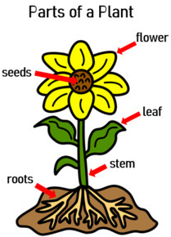
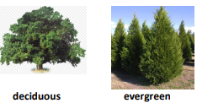
Science | Plants | Year 1 | Summer Term
Key Knowledge
Garden Plants | Plants that people choose to grow in their gardens
Wild Plants | A wild plant seed grows where it falls. It doesn’t need to be planted and cared for as it grows.
Weed | Wild plants that grow in places where people don’t want them
Deciduous | Deciduous tree loses its leaves each year
Evergreen | Evergreen tree keeps its green leaves all year round, even in the winter
Statutory Requirements
Identify and name a variety of common wild and garden plants Identify and name a variety of deciduous and evergreen trees Identify and describe the basic structure of a variety of common trees Identify and describe the basic structure of a variety of flowering plants
Key Vocabulary
Plant | Plant is a living thing that usually grows from the ground
Root | Part of a plant that takes in water and nutrients from the soil
Stem | Part of a plant that helps support and keep the plant upright
Leaf | Part of a plant that absorbs sunlight which is used by the plant to make food
Flower | Part of a plant that attracts insects and birds
Seed | Part of the flowering plant that can grow into a new plant
Possible Experiences
Plant a bean or a seed and watch it grow. Record your observations in a diary. Go on a wild plant hunt. Create a tally chart to show how many of each plant you have found. Plant some garden plants, care for them and watch them grow. Go on a tree hunt around Oakwood Park. What types of trees can you see? Collect fallen leaves and identify which tree they came from using pictures to help you. Sort the leaves between deciduous and evergreen trees.

