Slide 1
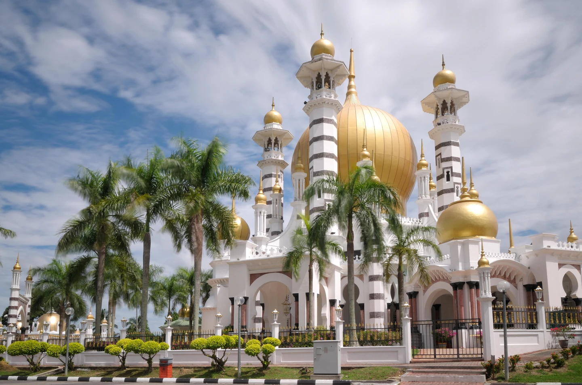
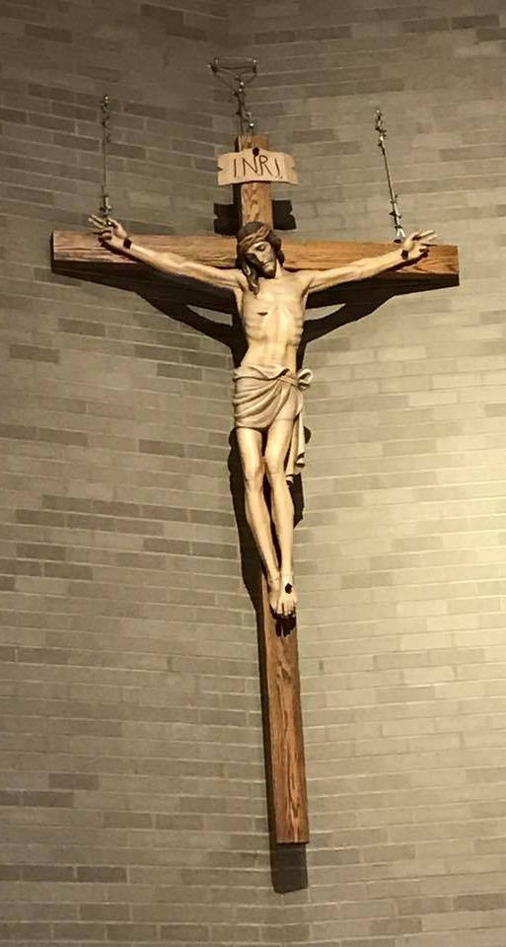
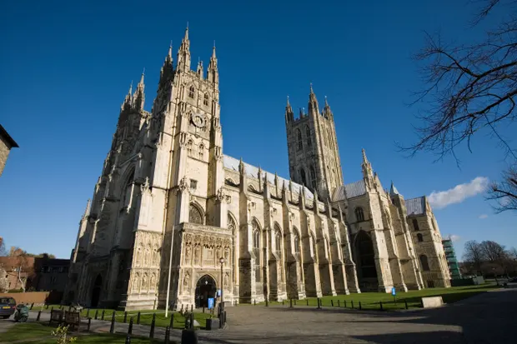
RWV | Is it better to express beliefs in art or charity? | Year 6 | Autumn 1
Key Knowledge
Discovering a new place is often very exciting. For some people, the most important place to them is a place connected to God (a sacred place).
There are some world-famous places that are considered sacred such as Jerusalem, the River Ganges and Mecca (Makkah), but there are also local places of worship that are sacred too.
In Islamic art and architecture, there are no images of Allah and often no images of humans. Instead geometric and natural patterns are used to convey the beauty and admiration of Allah with some artists creating some wonderful art containing each of the 99 names for Allah. Calligraphy is also found in and around many mosques. There are around 2100 mosques in the UK, each unique but with some common features such as domes, minarets and mihrabs.
In contrast, in churches and cathedrals across the UK, there are many different pieces of art work displaying events within Jesus’ life and of other important Christian figures. These buildings have been created, often over many hundreds of years, to make space for people to worship God and to express in architecture a Christian sense of the grandeur of God.
Within the Qur’an there are many messages about being charitable. Zakat is one of the Five Pillars of Islam and is a commitment to giving a percentage of wealth to charitable causes.
Within the Bible, there are also many different stories about generosity and helping those in need such as The Rich Young Ruler and The Good Samaritan. Many Christina charities are inspired by these stories.
Enfield SACRE Statutory requirements
A1 - Describe and make connections between different features of the religious and non-religious worldviews they study, discovering more about celebrations, worship, pilgrimages and the rituals which mark important points in life, in order to reflect on their significance. B2 - Understand the challenges of commitment to a community of faith or belief, suggesting why belonging to a community may be valuable, both in the diverse communities being studied and in their own lives. B3 – Observe and consider different dimensions of religion, so that they can explore and show understanding of similarities and differences within and between different religious and non-religious worldviews. C2 – Consider and apply ideas about ways in which diverse communities can live together for the wellbeing of all, responding thoughtfully to ideas about community, values and respect.
Prior learning
Throughout EYFS, KS1 and KS2, children will have learnt about discrimination and prejudice across the curriculum. They will understand the definition of racism and have some understanding of how people have been treated unfairly because of their race.
Key vocabulary
Spelling | Definition
Sacred | Something that is connected with God or a religion.
Architecture | The art or practice of designing and constructing buildings.
Minaret | The tall tower where the Muezzin calls to prayer from.
Mihrab | An alcove within the prayer wall which shows the direction of Mecca.
Calligraphy | Decorative handwriting.
Salvation | Being saved from sin.
Zakat | The obligation that an individual has to donate a certain proportion of wealth each year to charitable causes.
Key images
Possible experiences
Create a piece of art that reflects your beliefs
Hold a class debate to argue the unit question
Possible deeper thinking questions
Should only rich people be charitable?
Does charity begin at home?
Should people spend lots on restoring sacred places?

