Slide 1
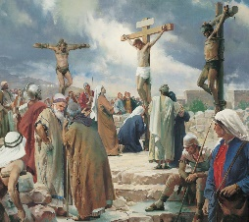
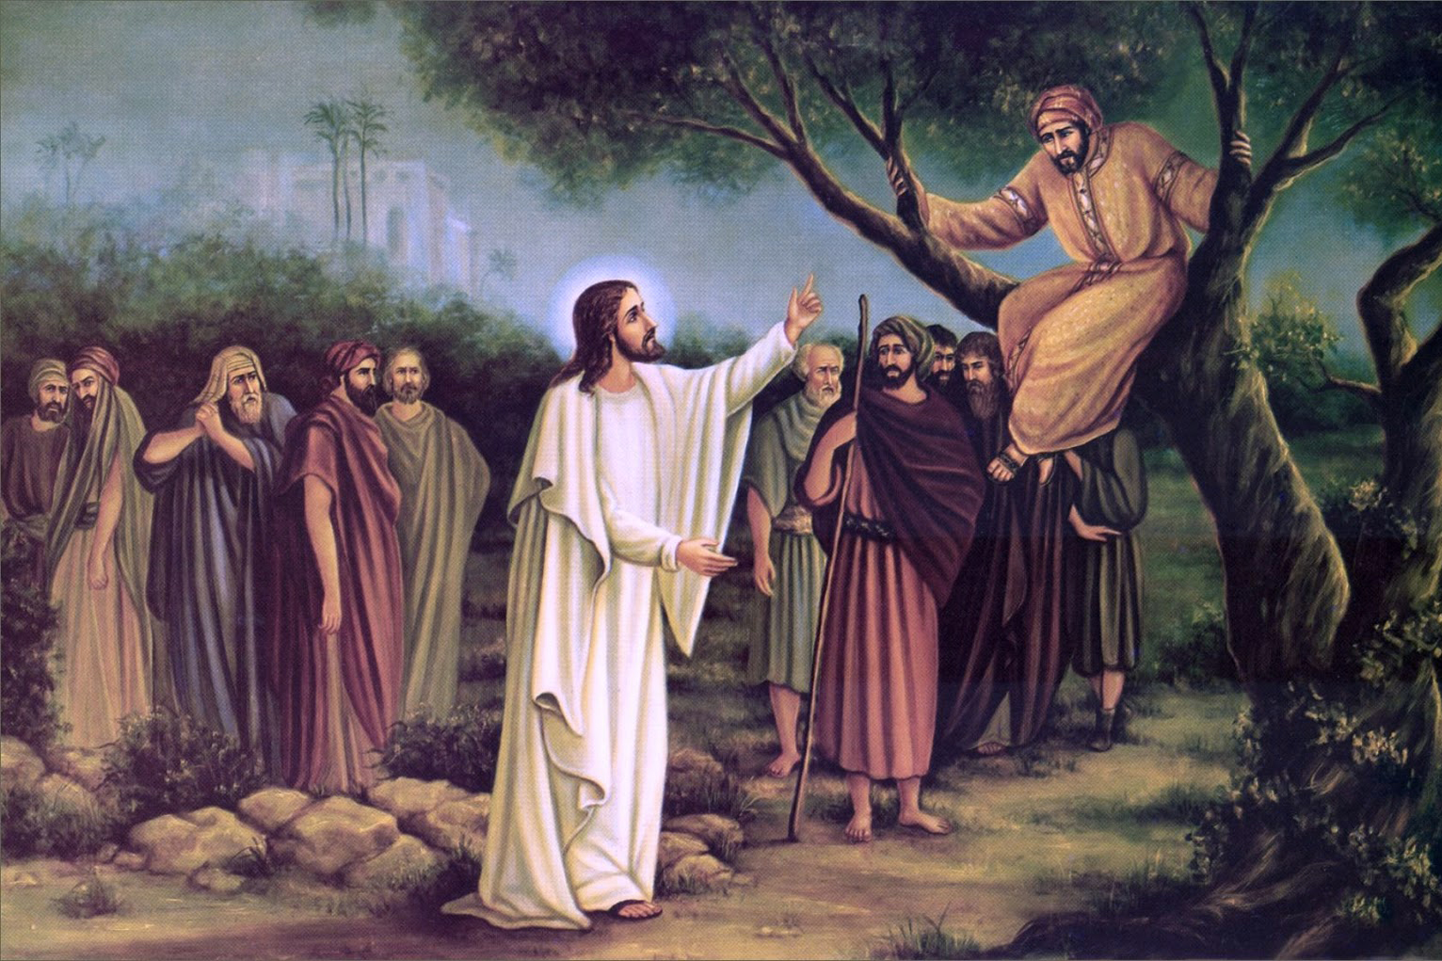
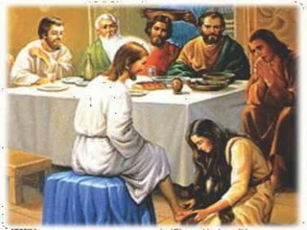
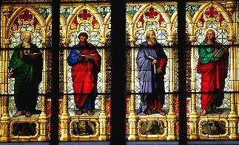
RWV | What would Jesus do? | Year 5 | Autumn 1
Key Knowledge
Many Christians believe the words and teachings of Jesus are recorded in the gospels, in the New Testament of the Bible. They also believe that Jesus had a mission to achieve during his time on Earth.
Throughout the Bible, there are also regular mentions of love and how Jesus showed love to a range of different people. Part of this was also teaching about forgiveness. Many Christians believe the ultimate example of forgiveness came when Jesus was crucified yet he still asked God to forgive his killers.
Other themes running through Jesus’ teachings in the Bible are fairness, generosity and greed. The stories teach Christians that generosity isn’t only about money, people can be generous with their time, live, kindness, words etc. They teach that if people work together to help those in need in any way they can, there would be more equality in the world.
For many Christians nowadays, when they face a problem or a dilemma, they spend some time thinking about what Jesus would suggest or do. They aim to share his morals and follow his example in order to solve their problems.
Enfield SACRE Statutory requirements
A2 – Describe and understand links between stories and other aspects of the communities they are investigating, responding thoughtfully to a range of sources of wisdom and to beliefs and teachings that arise from them in different communities B1 – Observe and understand varied examples of religious and non-religious worldviews so that they can explain, with reasons, their meanings and significance to individuals and communities. B3 – Observe and consider different dimensions of religion, so that they can explore and show understanding of similarities and differences within and between different religious and non-religious worldviews. C3 – Discuss and apply their own and others’ ideas about ethical questions, including ideas about what is right and wrong and what is just and fair, and express their own ideas clearly in response.
Prior learning
In EYFS & KS1, children will have learnt about different places or worship and some main beliefs of Christianity. In Years 3 & 4, children will have learnt more about the Bible, Christian practices and the life of Jesus.
Key vocabulary
Spelling | Definition
Parable | a simple story which has a special religious or moral meaning at the end
Moral | the concept of doing the right thing
Mission | a task or job that is assigned to someone by themselves or others
Gospel | translates as “good news”, it is the news about Jesus
Forgiveness | letting go of feelings of resentment, hurt and anger
Generosity | the desire to give what you have to others
Greed | you want more and more of something, often more than you need
Dilemma | a difficult situation in which you have to choose between two or more alternative
Key images
Possible experiences
Re-enact one of the parables
Create a modern day parable
Think about and act on different ways we can show generosity to other
Invite a Christian in to speak about the different way Jesus’ actions influence their decision making
Possible deeper thinking questions
Is Jesus the perfect example to us?
Are Jesus’ teachings still relevant today?

