Slide 1
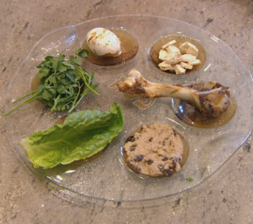
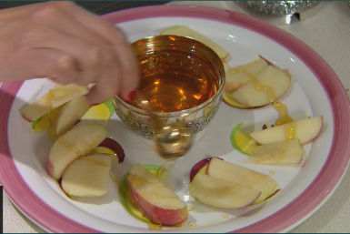
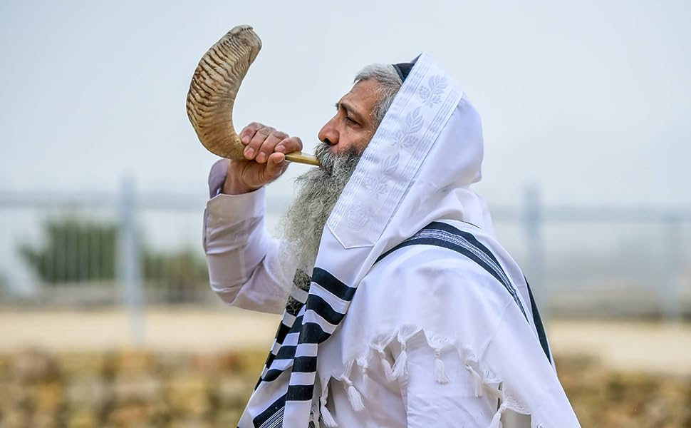
RWV | How do family life and festivals show what matters to Jewish people? | Year 4 | Autumn 1
Key Knowledge
Many people celebrate different significant events in their lives in a variety of ways. Some of these events are religious and some are not.
Jewish people have many special days throughout the year but one happens every week – this is called Shabbat. For Jewish people, Shabbat recognises that when God created the World, he did so in 6 days. On day 7, he rested. In the 10 commandments that were given to Moses, commandment 4 states that Jewish people should remember they Sabbath (Shabbat) and keep it holy. On this day they will rest, visit the Synagogue and focus on their faith.
The festivals of Rosh Hashanah and Yom Kippur are also important times for Jewish people. Rosh Hashanah is the start of the Jewish new year when they eat sweet foods like apple and honey to symbolise the sweet new year ahead and spend time in the Synagogue. A shofar horn is blown to focus everyone’s attention and signify the start of the ten days of repentance. Yom Kippur is at the end of the ten days and is the holiest day in the Jewish calendar where many Jewish people spend the day fasting, praying and asking for forgiveness.
Pesach (Passover) is another important day in the Jewish calendar. It celebrates the story of Exodus when the Jewish people were freed from slavery in Egypt. They eat a special meal containing food that symbolises the suffering of the slaves and their struggle for freedom.
These festivals give Jewish people a chance to remember the past, look to the future, apologise for mistakes, show appreciation for what they have and their freedom.
Enfield SACRE Statutory requirements
A3 – Explore and describe a range of beliefs, symbols and actions so that they can understand different ways of life and ways of expressing meaning. B1 – Observe and understand varied examples of religious and non-religious worldviews so that they can explain, with reasons, their meanings and significance to individuals and communities. C1 – Discuss and present thoughtfully their own and others’ views on challenging questions about belonging, meaning, purpose and truth, applying ideas of their own in different forms including (e.g.) reasoning, music, art and poetry.
Prior learning
Throughout Key Stage 1, children have studied the main beliefs of different religions and more specific information about main Jewish beliefs In Year 3, children looked in more detail at a range of religions and the special times they celebrate.
Key vocabulary
Spelling | Definition
Significant | Something important
Shabbat | The day of rest
Commandment | Something that God has told someone to do
Shofar | A ram’s horn blown at Rosh Hashanah
Repentance | When a person wants to get rid of the sin that it has committed
Forgiveness | no longer feeling angry at, or upset with, another person, or at yourself
Exodus | The departure of a large number of people
Gratitude | appreciating the person or thing that did something good for you or made you feel happy
Key images
Possible experiences
Taste some of the food eaten at these festivals
Create a list of things you are grateful for and make a plan for how you will show your gratitude.
Possible deeper thinking questions
Why should you think about the past?
Can you always have a fresh start each year?

