Slide 1
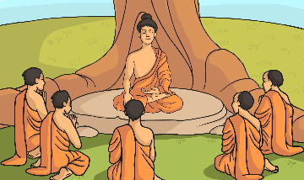
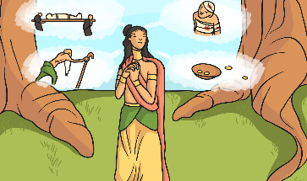
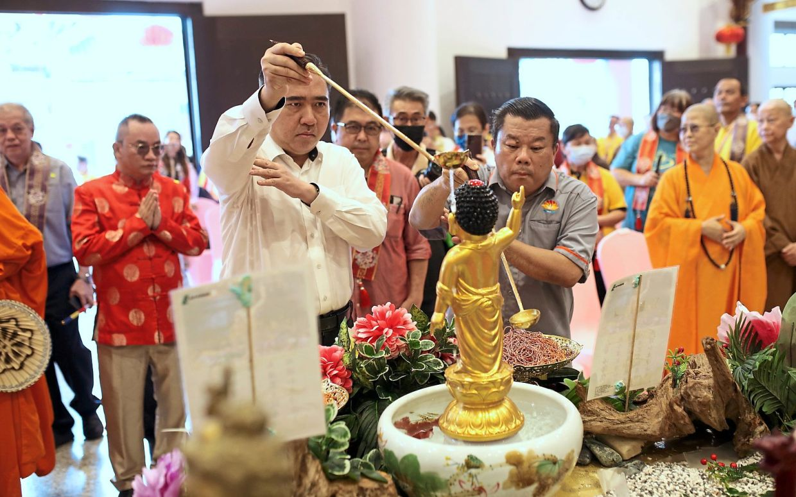
RWV | Who is a Buddhist and what do they believe? | Year 3 | Autumn 1
Key Knowledge
Buddhism was started by a man called Siddhartha Gautama who was later known as Buddha.
Siddhartha Gautama was born into a royal family in Nepal and for much of his life, he was surrounded by riches, wealth and youth. He had never left the palace and so hadn’t witness poverty, poor health or old-age. One day he decided to leave the palace and see what life was like on the outside. He saw an old man, a sick man and a dead man. For the first time, he realised suffering existed. He then saw a holy man with very few belongings, begging and wearing rags but looking completely content. He wondered how anyone could be so peaceful when they had nothing. He decided to leave his riches behind and find out for himself what true happiness was.
Siddhartha went into the forest and sat under a Bodhi tree and meditated for a very long time. During this time he realised the truth of happiness and became enlighten. He started to share this with others and was then known as Buddha.
Buddha told his followers about the four noble truths: suffering exists, we cause suffering by the way we think, we can stop suffering by thinking differently, if we all follow Buddha’s rules, we can end suffering.
Three of Buddha’s rules are: do not kill living things, do not steal from others and do not lie or talk badly about others. Buddhists honour Buddha and share stories to help remind them how they should live their lives.
During a special festival called Wesak, Buddhist celebrate Buddha’s life. It is a very happy and colourful festival where Buddhist clean their homes, visit their temple to bath Buddha, give offerings to monks and light candles.
Enfield SACRE Statutory requirements
A1 - Describe and make connections between different features of the religious and non-religious worldviews they study, discovering more about celebrations, worship, pilgrimages and the rituals which mark important points in life, in order to reflect on their significance. A2 – Describe and understand links between stories and other aspects of the communities they are investigating, responding thoughtfully to a range of sources of wisdom and to beliefs and teachings that arise from them in different communities. B2 -Understand the challenges of commitment to a community of faith or belief, suggesting why belonging to a community may be valuable, both in the diverse communities being studied and in their own lives. C3 - C3. Discuss and apply their own and others’ ideas about ethical questions, including ideas about what is right and wrong and what is just and fair, and express their own ideas clearly in response.
Prior learning
Through EYFS and KS1, children will have learnt about different religions and the main beliefs within them. They will understand different believe follow different beliefs and practices.
Key vocabulary
Spelling | Definition
Wealth | Having a great amount of money or possessions
Greed | An excessive desire for more of something
Suffering | To feel pain, upset or misfortune
Content | Happiness and satisfaction that you have everything you need
Meditation | A practice of mindfulness and self-awareness – calming your mind and body
Enlightenment | Finding the truth about something – for Buddha it was finding the truth about life
Monk | Someone who has taken strict religious vows and dedicated their life to becoming closer to their faith.
Buddha | The enlightened one, the first teacher of Buddhism.
Key images
Possible deeper thinking questions
Do you think you can be happy with no money?
Do Buddha’s teachings still apply today?
Possible experiences
Try and spend a day living with the most basic items.
Create a Wesak craft

