Slide 1
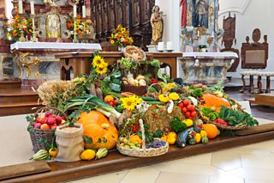
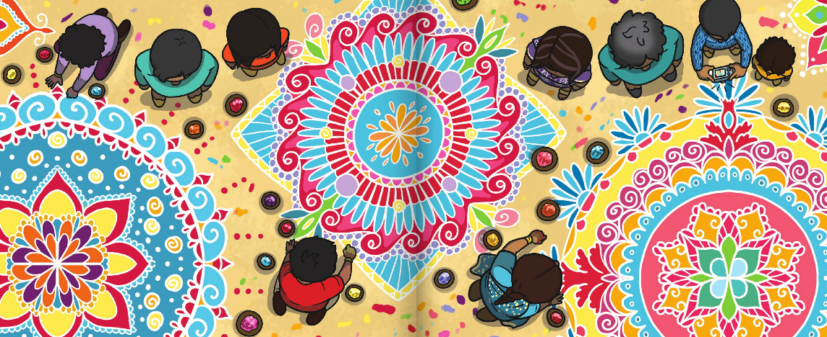
RWV | How and why do we celebrate special and sacred times? | Year 1 | Autumn Term
Key Knowledge
Harvest Festival is a celebration of the food that is grown on the land. Celebrations giving thanks for our food happen in many countries around the world. In Britain, Harvest Festivals are often celebrated by donating food and giving thanks to God as many Christians believe that God made the world and everything in it.
Diwali is a very important festival for Hindu people. It is a celebration of light over dark and good over evil. It is also known as the festival of lights. The festival is normally in October or November and lasts for five days. During Diwali, many Hindus celebrate by cleaning/tidying, buying new clothes, lighting diya/diva lamps, creating Rangoli art work, decorating their homes, eating big family meals, visiting their temples to pray, re-telling the story of Rama and Sita and watching firework displays.
Christmas is one of the biggest festivals for Christians as it celebrates the birth of Jesus. The nativity is a story about the journey Jesus’ parents, Mary and Joseph, took to Bethlehem and how after Jesus was born in a stable, an angel and a bright star appeared to let people know the son of God had been born. Some shepherds and three wise men travelled to Bethlehem to see Jesus and they gave him gifts. Many Christians exchange gifts at Christmas and visit church to remember Jesus.
Enfield SACRE Statutory requirements
A1 - Recall and name different beliefs and practices, including festivals, worship, rituals and ways of life, in order to find out about the meanings behind them. A2 - Retell and suggest meanings to some religious and moral stories, exploring and discussing sacred writings and sources of wisdom and recognising the traditions from which they come B1 - Ask and respond to questions about what individuals and communities do, and why, so that pupils can identify what difference belonging to a community might make. C1 - Explore questions about belonging, meaning and truth so that they can express their own ideas and opinions in response using words, music, art or poetry.
Prior learning
In EYFS, children will have gained some knowledge of stories, people, places, and times that are special within different religions. They will also have some understanding of belonging and the world around us.
Key vocabulary
Spelling | Definition
Celebration | Doing something special for an important event.
Festival | A special day to celebrate an event.
Harvest | Collecting what has been planted and grown in the ground.
Diwali | An important Hindu festival, also known as the festival of lights, that celebrates good over evil.
Christmas | An important Christian festivals that celebrates the birth of Jesus.
Key images
Possible experiences
Invite a Christian in to talk about Harvest and/or Christmas
Participate in a food collection
Have a Diwali celebration day
Possible deeper thinking questions
How do festivals help us remember special moments or people?
Are gifts more important or stories?
Why are festivals important?

