Slide 1
British Values
1st – 7th February 2021
Individual Liberty
At different times in our lives, we can choose to challenge ourselves. When we do, we need to manage the risks and understand the consequences of our actions.

Slide 3
United Nations Rights of a Child
Children can face many mountains,
e.g. feeling different because of speaking
a different language, our
religion, whether
we are a boy or girl, rich or poor.
no child should be treated unfairly for
any reason.

Slide 4
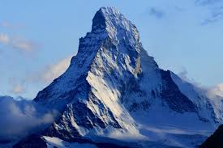
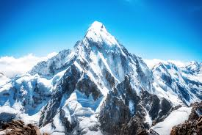
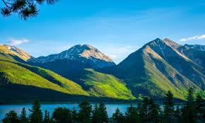
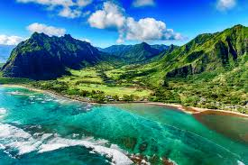
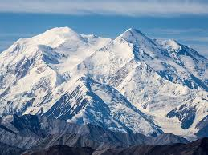
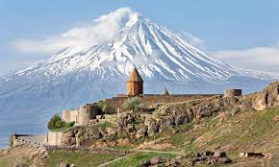
Listen, think, share
Can you describe what a mountain is?
Where is the highest mountain in the world?
Who has climbed the world’s highest mountains?
Does anyone know where it is or what we think might be happening in the picture shared today?

Slide 5
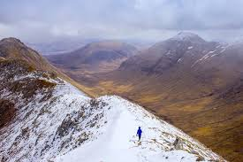
Listen, think, share - Answers
A mountain is like a hill but much higher. In the UK, it is classed as a mountain if it is at least 610m tall. The highest mountain in the UK is in Scotland and it is called Ben Nevis. It is 1345m high.
Mount Everest is the highest mountain in the world and is about 8848m! It is part of the Himalayan mountain range.
Jordan Romero currently holds the title for the youngest person to reach the summit of Mount Everest. The American was 13 years and 10 months old when he made it to the top on 22nd May 2010.
The picture is of a group of climbers have successfully climbed to the top of the world’s second highest mountain, K2, in freezing winter conditions! K2 is considered incredibly difficult to climb due to the high winds and sub-zero temperatures.

Slide 6
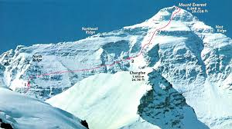
What do we know about Mount Everest?
Mount Everest is about 8848 metres (29028 feet) high.
• It was named in 1865 after British surveyor and geographer, Sir George Everest.
• On average, it takes 2 months to climb Mount Everest.
• The top of Mount Everest was first reached in 1953.
• The average temperature is -37⁰C.

Slide 7
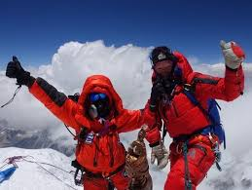
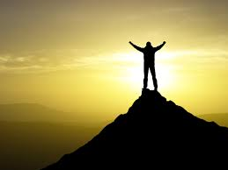
Reflection
Climbing any of the world’s highest mountains can be tough and dangerous but for some people, it is their goal or dream.
What is your goal or dream?

Slide 8
This Week’s Useful Vocabulary
Ascent – an upward journey, especially when walking or climbing.
Perseverance – continuing with something even though it is difficult.
Recent – having happened, begun or being done only a short while ago.
Sub-zero – lower than 0, below freezing.
Summit – the highest point of a hill or mountain.
Tackle – making determined efforts to deal with a problem or difficult task.

