Slide 1
British Values
28th September – 4th October
The Rule of Law
There are many new rules and laws that have been introduced to keep us safe during the Covid-19 pandemic. It’s important to understand why these rules have been made and how they help us.

Slide 2
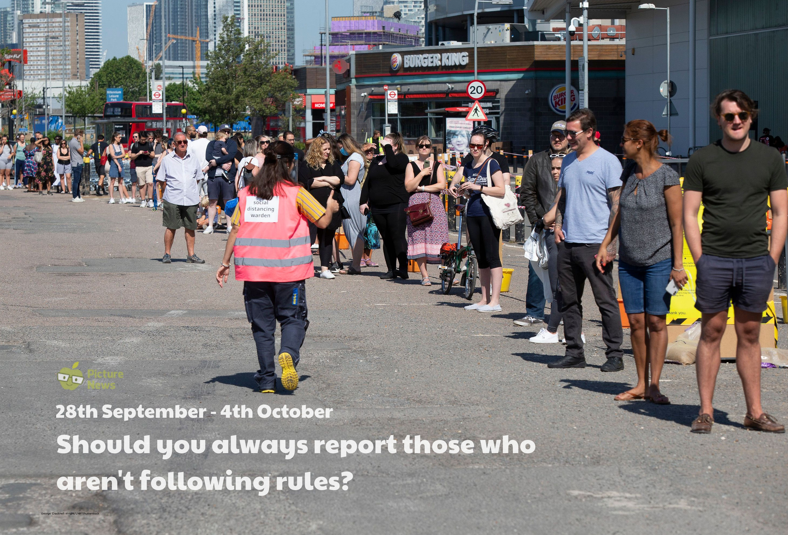

Slide 3
What is in the news?
It has been announced by Prime Minister, Boris Johnson, that Covid marshals will be introduced in towns and city centres in parts of the UK, to help ensure social distancing rules are followed. He believes that the public want to see ‘stronger enforcement’ of the rules. The government said marshals can either be volunteers or existing members of council staff from local governments.

Slide 4
Key Stage 1- Where are some of the places we have rules?
Have you ever had to follow any rules? What were they?
• Rules are instructions that tell you what you are allowed to do and what you are not allowed to do.

Slide 5
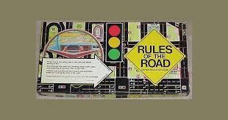
Key Stage 1-Look at the resource below, where some children share some of the rules they have to follow.
When I go to the swimming pool, one of the rules I have to follow is no running.
We have to stick to the path on one of my favourite walks.
One of the rules we have at home is to take our shoes off inside. This keeps our carpets clean.
We love playing games in our family. We make sure we follow the rules, so our game is fair.
Can you think of any other places where we might have to follow rules?

Slide 6
Key Stage 2-How can we keep everyone updated when rules change?
Some rules we might follow in our lives e.g. rules at school, home, when we play games, laws.
Why do we have these rules? Do these rules ever change?
Rules can change. Why might they change? For example, the rules in a game might change to encourage more people to play or a new rule about running in school might be introduced if there are lots of accidents.
During the Covid-19 pandemic, the rules have changed and been updated several times.
How do people find out about these changes?

Slide 7
Key Stage 2- Can you think of any other ways we could find out about changing rules?
Attend a meeting
Television
Internet
How can we keep updated when rules change?
Social Media Apps
Talking to people
Newspapers
Are all of these ways reliable?
Signs
Radio

Slide 8
Key Stage 2
Think about rules you have in school. Whose responsibility is it to find out about any rule changes you may have had recently? If you break a rule, but didn’t know about it, are you to blame? What are the consequences of breaking rules in school? Does anybody help you to follow rules?

Slide 9
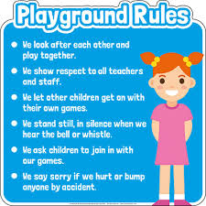
Key Stage 1 – Follow Up Work
Ask the children to think of an active game they enjoy playing during PE lessons or on the playground e.g. tig, football, stuck in the mud, what time is it Mr Wolf?
• What are the rules of these games?
• Why do we have these rules? Explain that the rules help to make sure our games are fair and to help us understand what we need to do.
• What happens if someone doesn’t follow the rules? Use PE or active time to play some Covid-safe games such as football rounders.
Share the rules and play the game!

Slide 10
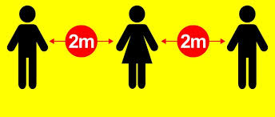
Key Stage 2 – Follow Up Work
Focus on this week’s main question.
Write the statement ‘You should always report those who aren’t following the rules’ on the board.
• Share your opinion.
• Does everybody agree with you?
• Do the circumstances surrounding the rule break alter whether it should be reported or not? Share children’s opinions and responses.
• Create a list of points both for and against. You could then have a formal debate or use their ideas to write an argument or discussion text.

Slide 11
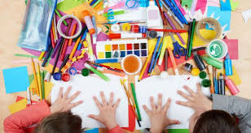
Reflection
There are many rules we follow in many aspects of our lives. We can choose to find out about these rules and we can choose to follow them.

Slide 12
This Week’s Useful Vocabulary
Announce – tell people about something publicly or officially.
Deliberately – to do something on purpose; consciously or intentionally.
Enforce – make sure a rule or a law is obeyed.
Pandemic – an outbreak of disease that has spread over several countries or the world.
Scheme – a large-scale plan or arrangement created by a government or other organisation.
Volunteer – someone who works without being paid because they want to do it.

